Slide 1
Lecture # 9 Introduction to Computer Programming CS161
Control Structures in Programming
Department of Computer Sciences Air University Multan Campus
Ahmad Mohsin

Slide 2
What we have covered in last Week Lectures?

Slide 3
Arithmetic assignment operators.

Slide 4
Today’s Topics
Decision Making
Decision Making & Programming
What are Control Structures?
Control Flow
If statement -- syntax – example
Flow chart for If Statement
Relational Operators
Relational Expressions & Conditional Statements
If Else Statements
Good Programming Practices

Slide 5
Decision Making in Real Life
In fact we are making decisions at every important point of life.
If you work hard ……. You succeed
If a person performs well in a company he / she gets bonus
If you have Rupees 5 lac in Bank Account you get some special offer …
Pakistan will win the Cricket Match if it plays first ….
You get discount on purchase if your purchase exceeds 3000
If your CGPA > = 3.5 you will get AU→ Scholarship

Slide 6
Decision Making & Computer Programming
Computers are good in taking input of the data, calculating the results and showing you output. But these programming constructs alone can not be much useful without Decision making.
Computer programs are efficient enough to compare numbers and on the basis of these comparisons they give us useful results.
Decisions are useful for observing sales figures, examining profit & loss, project sales on the basis of decisions.
Comparing numbers, comparing expressions .. Giving results in true or false
Validation of user input
Decisions in program also help users to provide choices for performing specific tasks… like building menus.. etc

Slide 7
Control Structures
Sequential execution
Program statements execute one after the other
Transfer of control
Three control statements can specify order of statements
Sequence structure
Selection structure
Repetition structure

Slide 8
add grade to total
Corresponding Java statement: total = total + grade;
add 1 to counter
Corresponding Java statement: counter = counter + 1;
Sequence structure in computer programming

Slide 9
What are Control Structures?
“A program is usually not limited to a linear sequence of instructions. During its process it may bifurcate, repeat code or take decisions. For that purpose, C++ provides control structures that serve to specify what has to be done by our program, when and under which circumstances.” – CPlusPlus.com
Allows for non-linear execution
Allows for a logical decision for which lines of code get executed (also called blocks)
else
while
else if
if
switch
for
do while

Slide 10
Operators for Decision Making in C++

Slide 11
Relational Operators
< less than
<= less than or equal to
== equal to
>= greater than or equal to
> greater than
!= not equal to

Slide 12
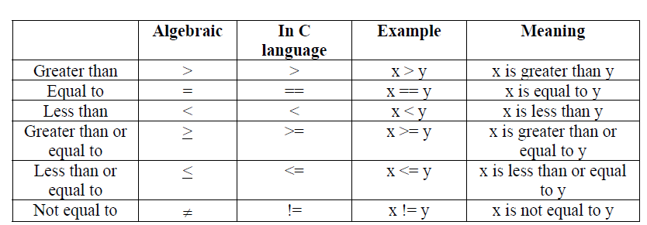
Relational Operators

Slide 13
Logical Operators
AND &&
OR ||

Slide 14
Logical Expressions
If a is greater than b
AND c is greater than d
In C++
if(a > b && c> d)
if(age > 18 || height > 5)

Slide 15
True .. & False
If condition is true then this statement / action
Else
Other statement or action
If (a >b)
Then
Do this
Else
Do that

Slide 16
If Statement syntax in C++
For as single or simple statement
If (condition)
statement ;

Slide 17
If Statement syntax in C++
For compound statement
If ( condition )
{
statement1 ;
statement2 ;
:
}

Slide 18
If statement in C++
if (num1 > num2)
cout<<“num1 is greater than num 2” ;

Slide 19
Example
If a cricketer scores more than 1500 runs in a domestic season in Pakistan in First Class season .. He is selected for National Team. Score is calculated on the basis of sum of his 10 matches in the season.
Lets do it.

Slide 20
Flow Chart for if statement
Entry point for IF block
IF
Condition
Then
Process
Exit point for IF block
Note indentation from left to right
Notes:
Connectors will come at the end

Slide 21
if-else syntax
if (condition)
{
statement ;
-
-
}
else
{
statement ;
-
-
}

Slide 22
if-else flow chart
Entry point for IF-Else block
IF
Condition
Then
Process 1
Else
Process 2
Exit point for IF block
Note indentation from left to right
Notes:
Connectors at the end

Slide 23
Example
If number is divided by 2 and remainder is 0 it should display it is Even Else ODD
If a cricketer scores more than 1500 runs in a domestic season in Pakistan in First Class season .. He is selected for National Team. Else he is advised to work hard
Score is calculated on the basis of sum of his 10 matches in the season.
If a student has > 70 % marks in the Admission test held in Air University he is offered Admission..
Else he / she is advised to appear again
Lets see on the board

Slide 24
Nested if statements
If (age > 18)
{
If(height > 5)
{
:
}
}
Make a flowchart of this nested if structure…

Slide 25
Nested if conditions --- Example
If (employee == ‘y’)
{
If (graduated == ‘y’)
{
cout<<“ congratulations your request is approved” ;
}
}
Make a flowchart of this nested if structure…

Slide 26
Similarly we can we nested if ..else statements…
We shall do in detail in next lecture

Slide 27
References & Readings
Dietel & Dietel C++ How to Program? Chapter No. 02 topic related to decisions Ch. No. 04 ( Topics 4.1 to 4.6)
Starting out with C++ from Control structures to objects, Tonny Gaddis. 6th Edition Chapter No. 04

